Slide 1


Notes:
Joe Zack, a full-stack dev, focused on BE
Talking JAMstack, which is a front-end focused methodology for building web apps that has recently caught my attention.
Show you what the JAMstack is
Why it’s gaining popularity
What it means for BE devs
---------------------
Joe Zack from Coding Blocks here talking to you about JAMstack – a front-end focused methodology for building web apps that has recently caught my attention.
Show you what the JAMstack is
Tell you why it’s gaining popularity
What it means for the back-end

Slide 2
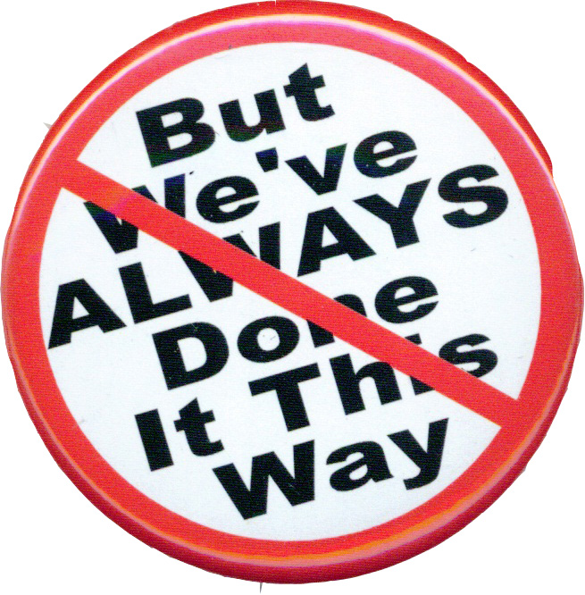
Notes:
Last time Alex had me here I gave a talk on Search Engines, and I spent a lot of that time comparing and frankly attacking relational databases. Don't get me wrong, I love relational databases, but I think that they are often over used and I don't like when organizations implicitly use them. Sometimes we don't even realize we are making a decision, because we aren't aware of alternatives. I want to fight that bias. I want to know what my options are, and I want my decisions to be explicit and informed in the hope that this makes for better decisions.
And that’s why I started looking at JAMstack.
I heard it was an interesting way of thinking about web applications that was making people question the way they did things.
I couldn’t resist that pitch, and now I’m bringing you that same message.
So put your skeptic’s hat on, and lets take a field trip to the front-end to see if the grass is any greener.
-------
Now I consider myself to be a Full Stack Developer, I like being able to work with both front-end and back-end code in order to completely solve a problem. However, I have a preference for back-end work because back-end work tends to be a bit more formal and regimented and the front-end evolves and changes so fast that it’s difficult to hang on to.
But despite me preferences, I’m here to solve problems and I want my solutions to be the best. In order to do that, I have to pay attention to the major trends in software engineering so that I can make conscious and informed decisions about how to solve those problems.
That’s why I started researching JAMstack. I had heard that it was an interesting approach to building web apps that was changing how programmers thought about the roles of front-end and back-end coding. As a full-stack dev, the veil between those two worlds is very important to me, so I couldn’t resist checking this out.
So now I’ve built a couple small JAMstack apps now, and I’ve really liked how things have turned out and now I’m here trying to convince you to re-evaluate the roles of front and backend development.

Slide 3
JavaScript
APIs
Markup
Notes:
What is the JAMstack?
The JAMStack is a methodology for building web apps that is based on client-side JavaScript, reusable APIs, and prebuilt Markup and it’s gaining popularity at the expense of some existing, entrenched technologies.
JavaScript
Client-Side JS
Framework agnostic
Build time rendering
Auth is handled outside the app, with API
APIs
All server-side processes or persistence are abstracted into APIs
All APIs are accessed over HTTPS from the JS
Treat your own server-side components as 3p
Plays nice with Microservices
Markup
Templated markup should be prebuilt at deploy time
Usually using a site generator or build tool
Separates your content from your look n feel
------
What is the JAMstack?
The JAMStack is a methodology for building web apps that is based on client-side JavaScript, reusable APIs, and prebuilt Markup JAM
JavaScript
Client-Side JS – no prescribed framework – can even be vanillaJS
Many of the modern front-end frameworks like React or Angular have a server-side build component – and that’s fine, but the output of that build process needs to be Client-side website that you can publish as a static site
APIs
Any server-side processes or persistence you need are abstracted into APIs that are called from your js – either at run time or even better at build time
Even server-side code that you owns needs to be treated as if it were a 3p service
Markup
The idea here is to keep your content decoupled content from your design
Talking about JAMstack it’s common for devs to use site generator or build tool to pull content from flat files or APIs
That’s fine, it’s not cheating – as long as you can publish the output as a static website

Slide 4
JAVASCRIPT
API
Markup
Notes:
Ok, so JavaScript, APIs and Markup
That just kinda sounds like a basic website
If anything, sounds like a step back in time to when dinosaurs like Geocities ruled the internet
But just bear with me a little longer so that we can talk about the benefits of build-time rendering

Slide 5
Best Practices
Static Website
CDN Hosting
Modern Build Tools
Single Git Repository
Atomic Deploys
Instant Cache Invalidation
Notes:
Where does the stack part come in?
Stack:
Misleading (MEAN, LAMP, Microsoft)
(Combination of complimentary technologies)
Have their own part to play and the result is greater than the sum of it’s parts
JAMstack is ambiguous
JAMstack is more of a methodology
Best practices that jive well with JAM
The app should be distributed on a CDN, the more on the edges, the better the UX
Modern Build Tools: Babel, WebPack, Gatsby, etc
Everything you need to run the app lives in a single git repository - simple npm install
Remember FTPing? Watchers more common now
Focus on automated builds, there is less emphasis on persistance, so changes generally need to be deployed
Atomic deploys (deploy everything at once instead of file by file)
Instant cache invalidation (use a CDN that can handle instant cache purges)
-----------------
So, we’ve talked about the JAM – but where does the stack come in?
Well… there kinda isn’t one.
When I think of a technology stack I think of a combination of complimentary technologies that work well together: Things like LAMP stack or MEAN, or Microsoft stack
JAMstack isn’t so rigidly defined, it’s much less prescriptive. It’s really just a set of best practices for building decoupled front-end websites, with a heavy emphasis on build-time rendering
I’ve got a list of best-practices up on the screen here, but all of these best-practices really revolve around those two core concepts:

Slide 6
Best Practices
Static Website
CDN Hosting
Modern Build Tools
Single Git Repository
Atomic Deploys
Instant Cache Invalidation
Decoupled front end
Build Time Rendering
Notes:
Deploying Decoupled static websites that can be hosted on a CDN, and Build-Time Rendering

Slide 7
Types of Rendering
Write
Server
Client
Build
Notes:
The server-side approach to this problem (take Wordpress for example) has been server-side rendering, having a back-end application server fetch the data from a database and generating the html on the fly. Since we read so much more than we write, then it’s common to introduce some sort of caching layer, like Redis, into the mix.
This works fine, but it’s not optimal.
The client side model isn’t much different, it just calls an API to get the data it needs and then dynamically generates the html and dynamically insert it into the web pages Document Object Model.
This also works fine, but it’s not optimal.
If our data doesn’t change much, and most data doesn’t, then we can take advantage of build time rendering.

Slide 8
Types of Rendering
Write
Server
Client
Build
Build Time
is
Best Time
Notes:
When I say “Build Time” rendering, I’m talking about fetching all the data that you can when you are building your application for deployment. I’m talking about querying your db, services, or filesystem up front.
This works great when you have data that doesn’t change often, take for instance a content heavy site where posts are often published once but read bazillions of times…like Wordpress
This is what static site generators were made for, and there is also a lot of work being done to try and enable traditional front-end frameworks to leverage build-time rendering: Angular AOT, React Pre-Pack for example.

Slide 9
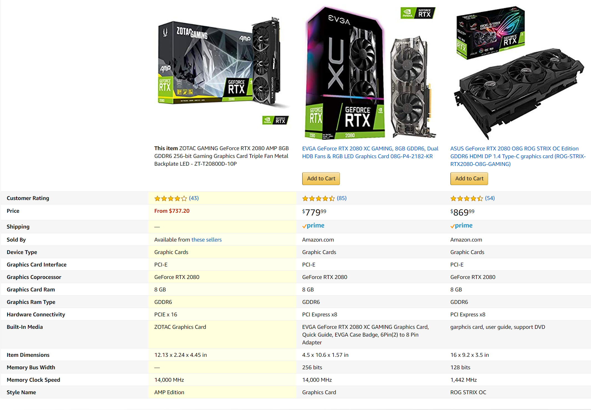
Notes:
But what if your data does change often?
Most “data” doesn’t change often, or at all. But some does, some data just needs to be real time.
There is nothing wrong with that, you just won’t be able to leverage the benefits of build-time rendering for those data points
If your application relies heavily on real-time data, then it’s probably not a great candidate for JAMstack.

Slide 10
Notes:
However, many applications only need a small percentage of their data in real-time.
There is nothing wrong with fetching the data you need in real-time, and you can still leverage build-time rendering for the data that doesn’t change as often.
E-Commerce webapps are actually a common use case for JAMstack applications, you just fetch the real-time data you need at run time.
Blogs and CMS are also common use cases, you just fetch the comments real-time.

Slide 11
Location Matters
Notes:
TODO Get numbers

Slide 12
Content Delivery Networks
Notes:
TODO Get numbers

Slide 13
CDN Hosting: The Best Hosting
performance
Security
Pricing
Scalability
Notes:
Static hosting on CDN is tough to beat
Great for devs, great for users
Perfect for side projects, CDN hosting is essentially free
Google loves it
Fast
PWA

Slide 14
Best Practices
Static Website
CDN Hosting
Modern Build Tools
Single Git Repository
Atomic Deploys
Instant Cache Invalidation
Decoupled front end
Build Time Rendering
Notes:
That’s what JAMstack is, a set of best practices for building decoupled front-ends with a heavy emphasis on build-time rendering

Slide 15
JAVASCRIPT
API
Markup
Notes:
Yeah, ok, so Build-Time rendering seems nice and CDN hosting is fantastic but neither of these are new concepts
So why am I still prattling on about JAMstack? Why is this even have a name in 2019?

Slide 16
Why now?
Proliferation of Managed Services
Netlify
GitHub
LetsEncrypt
Contently
Great tooling
React
Vue
Gatsby
Hugo
Notes:
We’ve reached critical mass

Slide 17
Why now?
Critical Mass
Managed Services
Great Tooling
Proliferation of Managed Services
Netlify
GitHub
LetsEncrypt
Contently
Great tooling
React
Vue
Gatsby
Hugo
Notes:
JAMstack works because the tools and services we use to build apps have multiplied and matured to a point where we can now shift the brunt of the work to the build step.
This frees developers up to work at a higher level.
Thanks to build time rendering and CDN hosting we can spend less time worrying about performance, scalability, security, and pricing.
We get to spend more energy on our problem domain – the things that make our solutions unique.
It makes us more efficient.

Slide 18

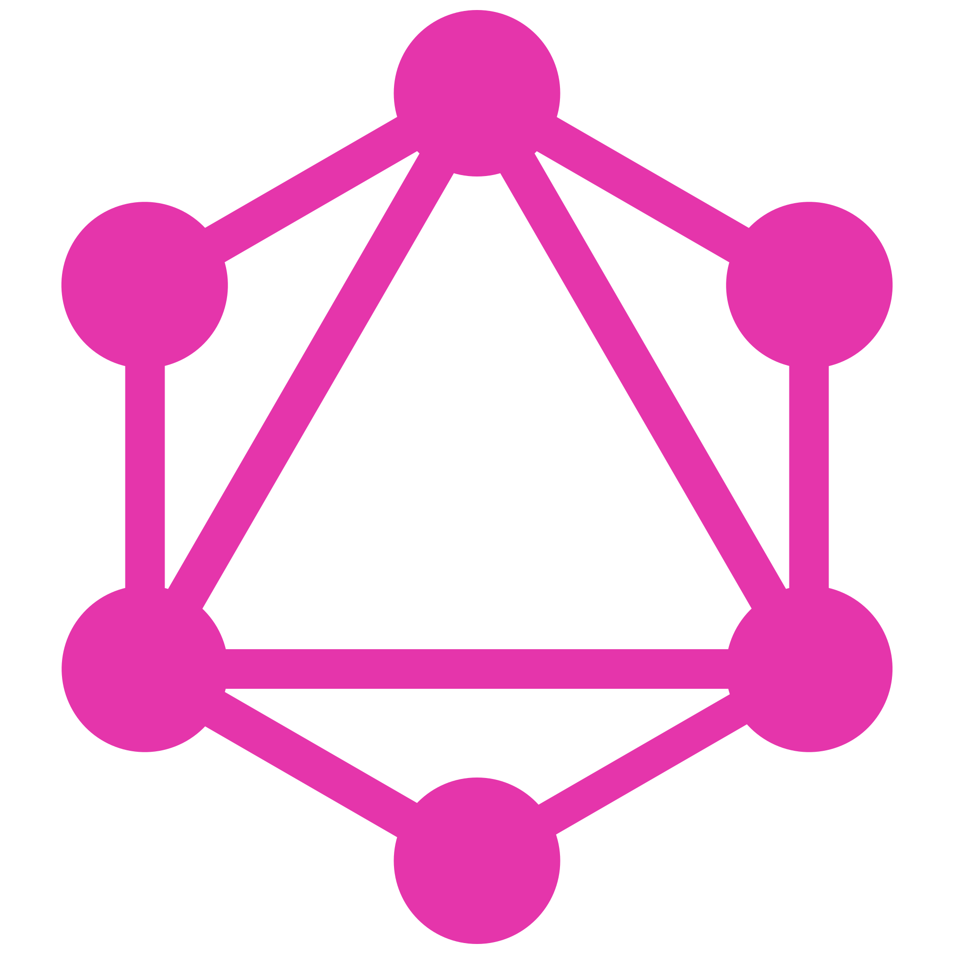

Notes:
Gatsby
React (Server Side Includes, Templating)
GraphQL (Isolation Layer Between Persistence)
Plugins for ETL
Host in GitHub
Netlify builds, publishes

Slide 19
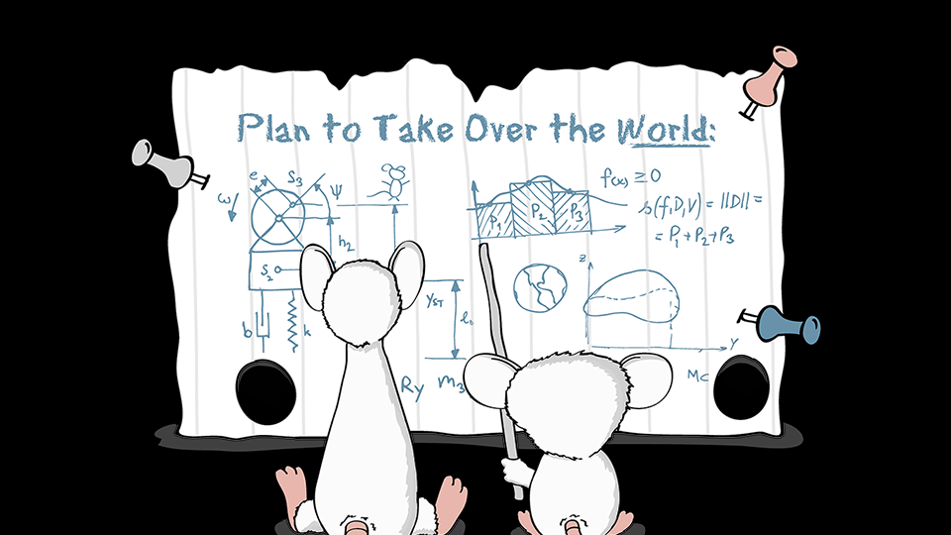
Notes:
Now we’ve seen what the JAMstack is all about, and what benefits it offers.
Lets talk about
------
Build time rendering
Decoupled front-end
Deployment

Slide 20
Downsides?
Big Data, Analytics
Non Developer Interactions
Real-Time Systems
Notes:
Scales great for users...but how do large projects scale for devs?
Steep learning curve for non-devs
Real-Time Data
Help from the audience!
Same downsides as a SPA

Slide 21





What value does the back-end provide?
Notes:
This is the most important screen in the whole presentation.
I don't know if we'll be talking about "JAMstack" in a few years, but I do think that we will see the front-end pushing more and more towards build time rendering.
This is an important trend for Back-End devs to watch, because build-time rendering changes the responsibilities of the back-end. You no longer need a back-end framework for server-side rendering. This can now be done better in the front-end, at build time. Why shouldn’t the front-end own the all of the html rendering? It’s closer to the browser, closer to the user, and it’s good at it.
The back-end is losing ground here, it is responsibilities to the front-end. I’m betting that the concepts behind JAMstack will continue to gain popularity. That popularity will be taken from the mature, entrenched technologies you see on this screen.
However, I’m arguing that this is a good thing.
If the back-end devs give up on server-side rendering. This completely frees the back-end up from front-end concerns. The back-end can now wholly focus on everything from the API layer down.

Slide 22
Notes:
Researching the JAMstack has changed how I view the roles of front-end and back-end coding. It has changed how I’m investing my development time now.
I no longer care as much if (for example) php has a better rendering experience than Flask. I’m going to favor the tools that make for better APIs

Slide 23
Notes:
- JAMstack is a set of best practices for building decoupled front-ends with a heavy emphasis on build-time rendering
- It’s quickly gaining popularity because the managed services and front-end tooling have reached a tipping point where it’s now easy to make great static sites at build time
- I am betting that Front-End and Back-End responsibilities are changing to focus on build-time rendering and APIs

Slide 24
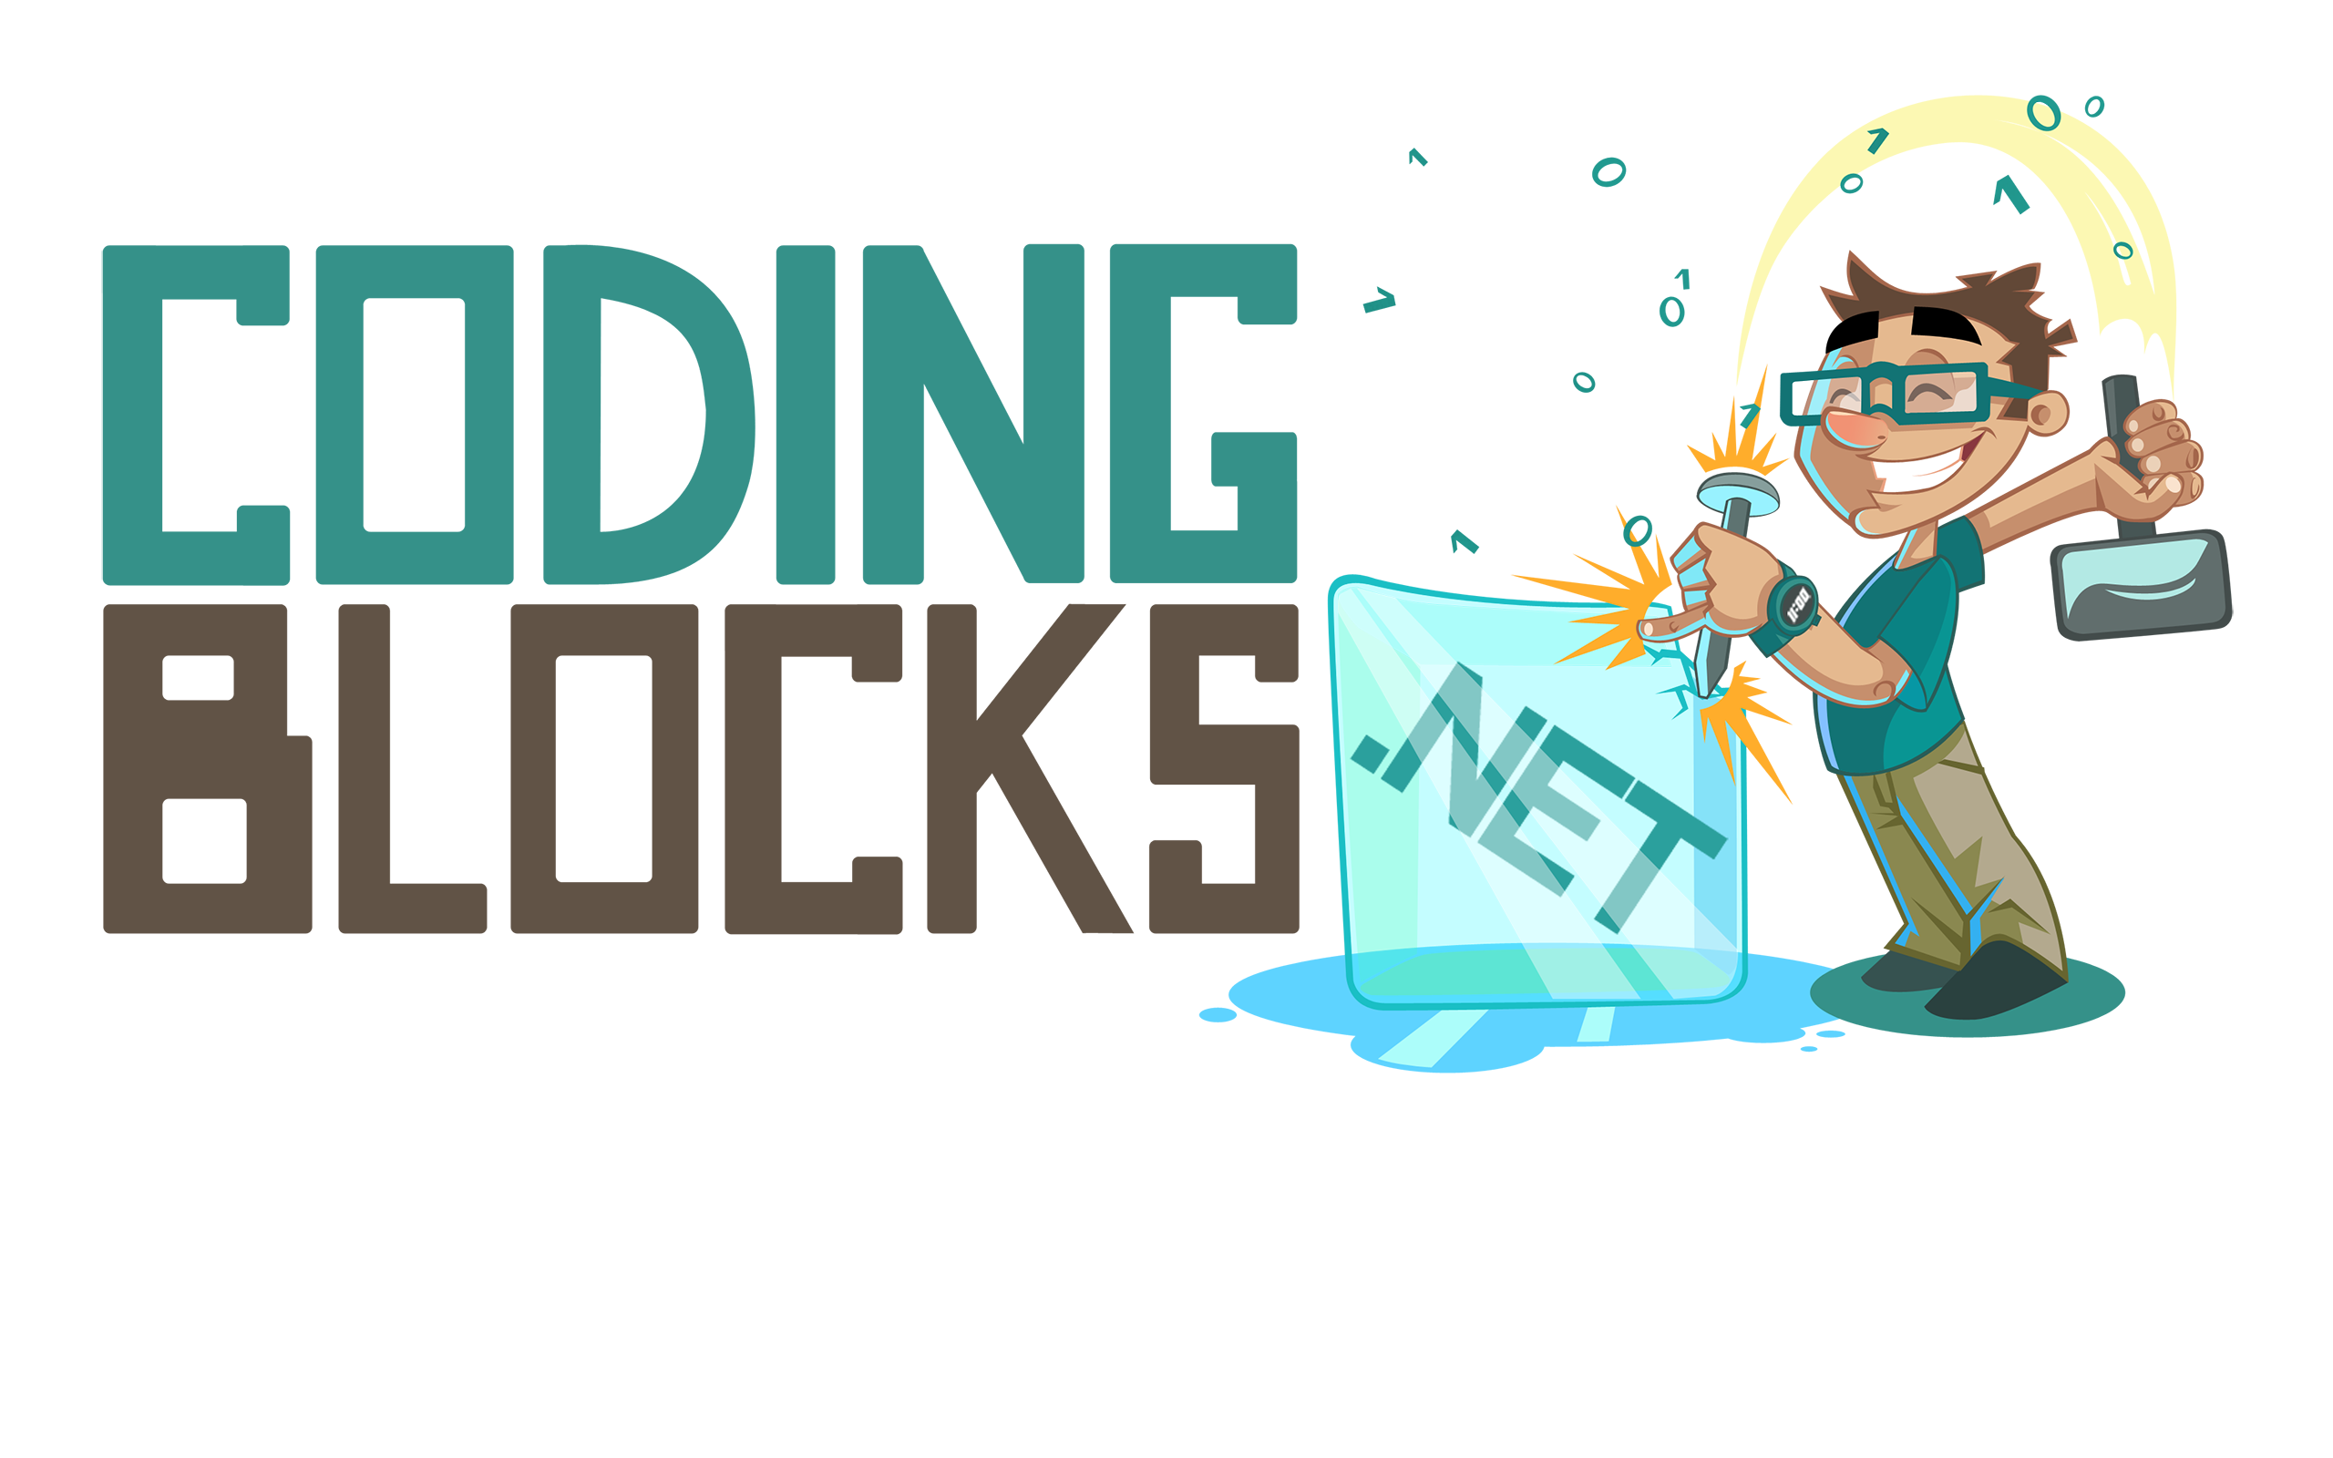
Like this talk? Check out the show!
Joe Zack
@codingblocks
github.com/codingblocks
Notes:
If you like this kind of talk, check out the Coding Blocks podcast or YouTubez, whatever
We don’t do guest interviews, we try to focus on “real” dev talk, like how front-end and back-end roles are changing.

